Slide 1
Choose Your Own Grading Schema: An Online Learning Experiment
Olivia Wood
PhD Candidate in English, CUNY Graduate Center
Graduate Teaching Fellow, John Jay College of Criminal Justice
Digital Pedagogy Fellow, City Tech OpenLab

Slide 2
Fall 2020
Course Policies
Results
Zoom Class = Optional
Primarily asynchronous, using CUNY Commons
No penalties or cutoffs for late work
Can revise assignments as many times as you wish
Attendance at Zoom Class declined over time and became, essentially, office hours
Students’ final reflections split about 50/50 in response to these policies

Slide 3
Quotes from Students
“[I suggest] to make the zoom meetings/class sessions mandatory. I say this because of my own experience, since it was optional I personally never attended and it made me engage less in the course. Now looking back I regret it, because I think if they were mandatory I would’ve attended, been more engaged, and more on top of my work. I don’t want others to experience the same thing.”
“I would prefer meeting on zoom to be mandatory so people are actually motivated to go to the class and not miss out on work or directions”
“I think you should do exactly what you did this semester for the rest of them. The way you structured this class for this semester was done very well.”
“I feel like you shouldn't change anything…You understand [the] students and sometimes we might be going there physical or emotional problems or mental problems by getting anxiety.
“Thank you Professor Wood for being so lenient and care about how we felt this semester.”

Slide 4
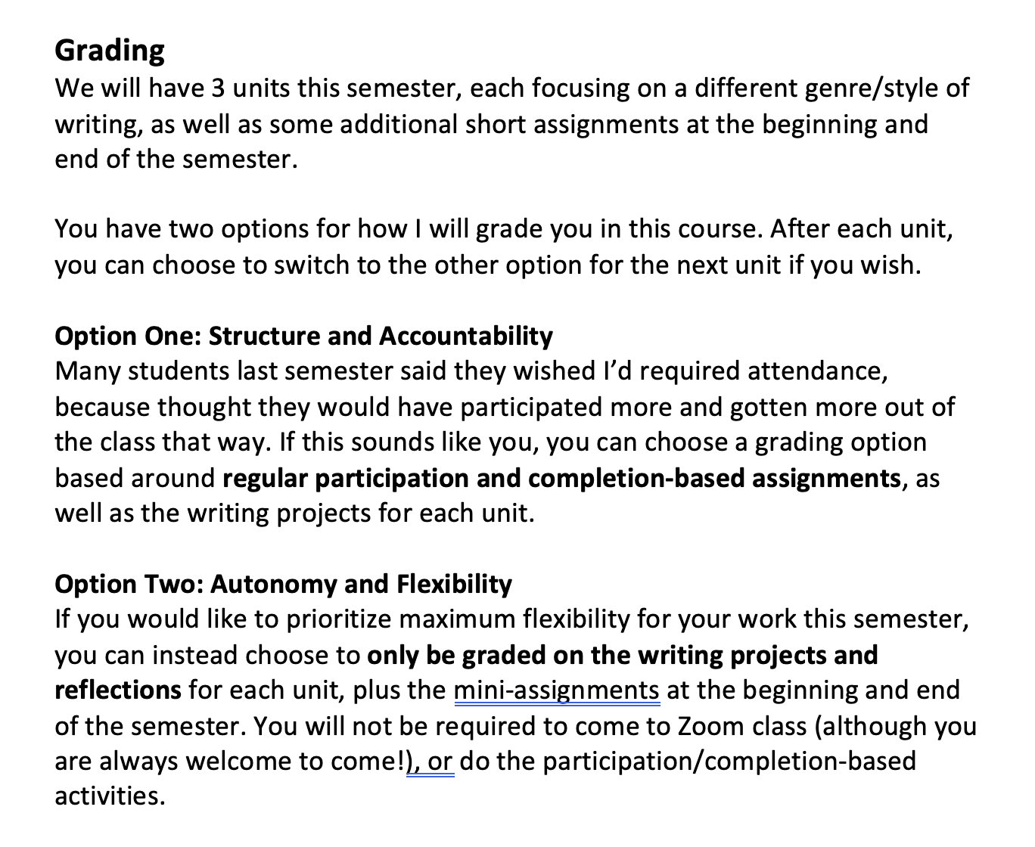
Spring 2021
Zoom class required for the 1st grading plan and optional for 2nd grading plan
Still no penalties or cutoffs for late work
Still can revise assignments as many times as desired
Synchronous on Tuesdays and asynchronous on Thursdays

Slide 5
Student Choices

Slide 6
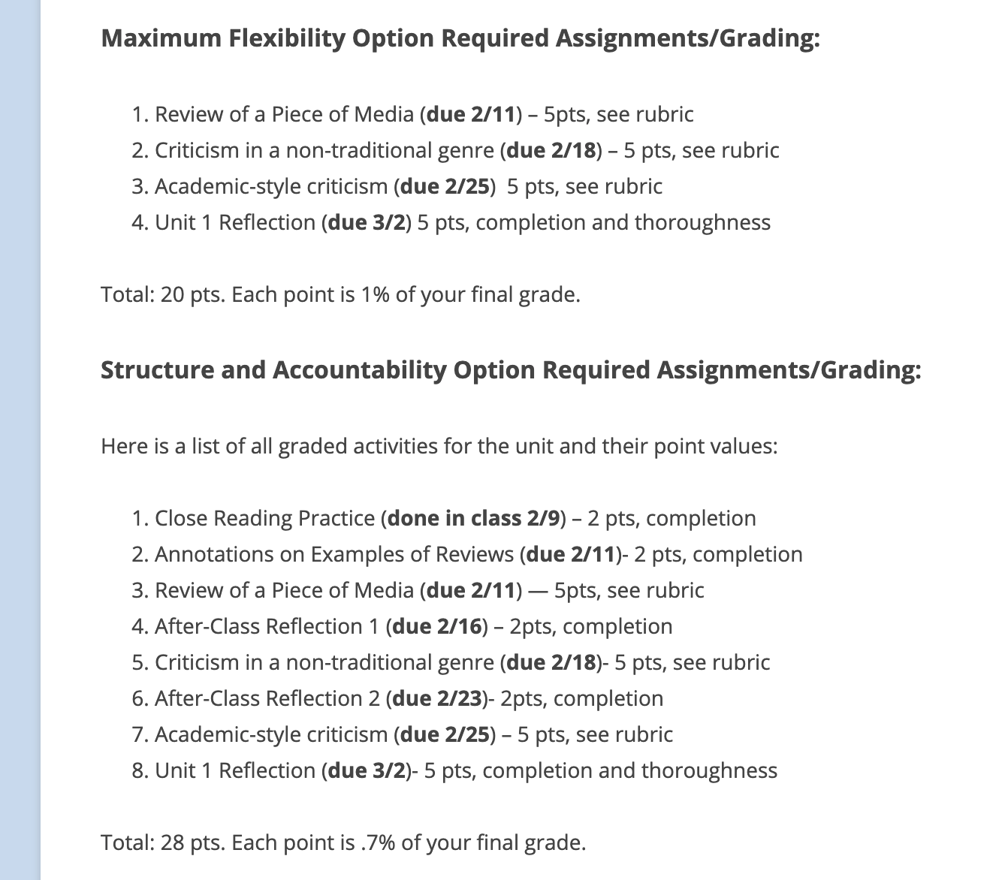
Additional Pedagogical Supports
Outlines of what assignments will be required for both grading plans posted before each unit
Reflections at the end of each unit ask students to consider:
What they did that helped them succeed in that unit
What they would like to do differently in the next unit
What additional resources or supports they would like

Slide 7
Comparing Semesters
Fall 2020
Spring 2021 (Currently)

Slide 8
Comparing Grading Plans
Almost everyone (8 students) with a C and below (9 total students) has chosen the Maximum Flexibility Plan for all 3 units
BUT, the other 10 students who made the same choices have As and Bs

Slide 9
Quotes from Students
“I think more professors/teachers should use your grading plans… It allows for students to figure out how they work best and how they create the best work possible.”
“The grading plans are good for students and it allows them to be responsible for their own work.”
“The reason I enjoy this is because it allows everyone to make their own decisions for the class because everyone has different situations going on in their life. Other teachers I feel don’t care about what others are experiencing and just teach the class mindlessly which I don’t like”
“It is something you should continue doing in future semesters. I feel strong and confident in this class. I am able to focus on my two jobs and school.”

Slide 10
Quotes from Students (cont.)
“I think the system of grading plans is perfect. You made sure to think about those other kids (including me) who do not really have the time to join a class. You made sure that although we did not go to class, that we still got credit for our work.”
“The ability to chose how we want to be graded is a very rare occurrence to have, so to have this opportunity is amazing considering the current climate we are in… this relaxed system gives me time to breathe, if that makes sense. I just feel as though this grading system is perfect for online school.”

Slide 11
Exceptions
“I wish there was only one grading plan. Having to choose is stressful for me and I wish I didn’t have the option to choose even though it's very…If class were in person, yes two grading options is a great idea because students can be engaged in class either way…However, being online, it’s very hard to focus and I wish you only offered one grading plan so I don’t have to choose.”
“There is nothing you should change other than kinda forcing students to attend zoom meetings. If you make it so that if they miss the zoom, they can't really do the assignments. That will guarantee a higher attendance rate for your class.”

Slide 12
Reflections
Definitely plan to continue this system in future semesters
Need to rearrange percentage breakdown of total grade for clarity
Blackboard doesn’t allow for automatically configuring different grading schema– I have to do it manually
Easy to track which students are on which grading plan with only 1 class– would need to figure out how to streamline it if I taught full time

