Slide 1
Bi and pansexual rhetorics of identity
Olivia wood
CUNY Graduate Center
Olivia-a-wood.com
Twitter: @bi_rhetorics

Slide 2
The rhetorical situation
Bi/pan people make up about 50% of the LGBTQ community
Bi and pan people face higher rates of many negative health and wellbeing outcomes compared to straight people, and often even compared to their gay and lesbian counterparts.
The disparity is even worse for bi/pan women and bi/pan people of color.
Largely thought to be chain-reactions from the effects of cultural erasure, invisibility, and biphobia

Slide 3
What is biphobia?
Bi/pan people still experience homophobia
Biphobia is another layer of prejudice:
  “Bisexuality is just a phase”
  “You’re really just (gay/straight)”
  ”You must want to cheat on your partner”
  “Bi people don’t belong at Pride”
  “Just pick a side”
  Invisibility and erasure not given to LG people

Slide 4
How do bi and pan people navigate this rhetorical situation? How do they choose to express, hide, and negotiate their identities across various situations?
My Question

Slide 5
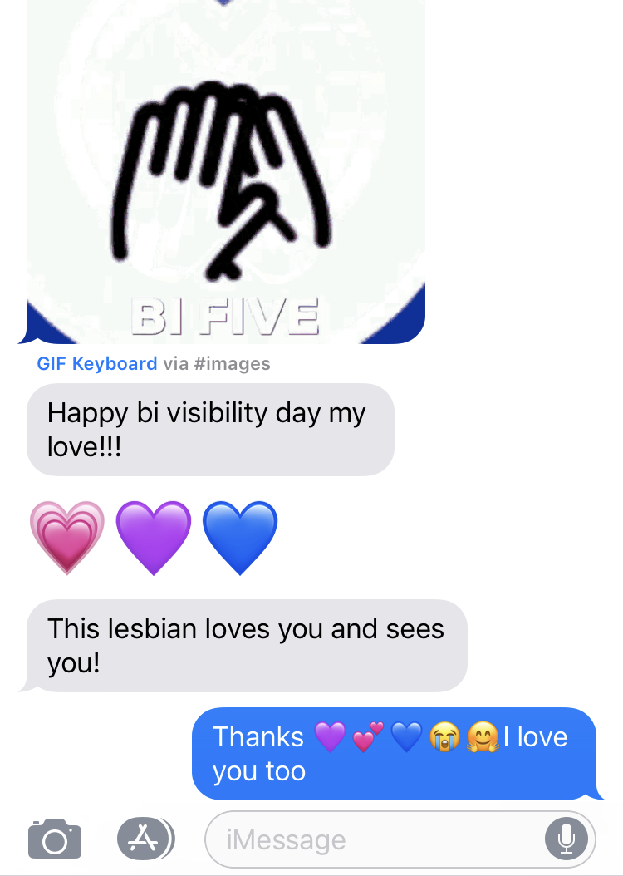
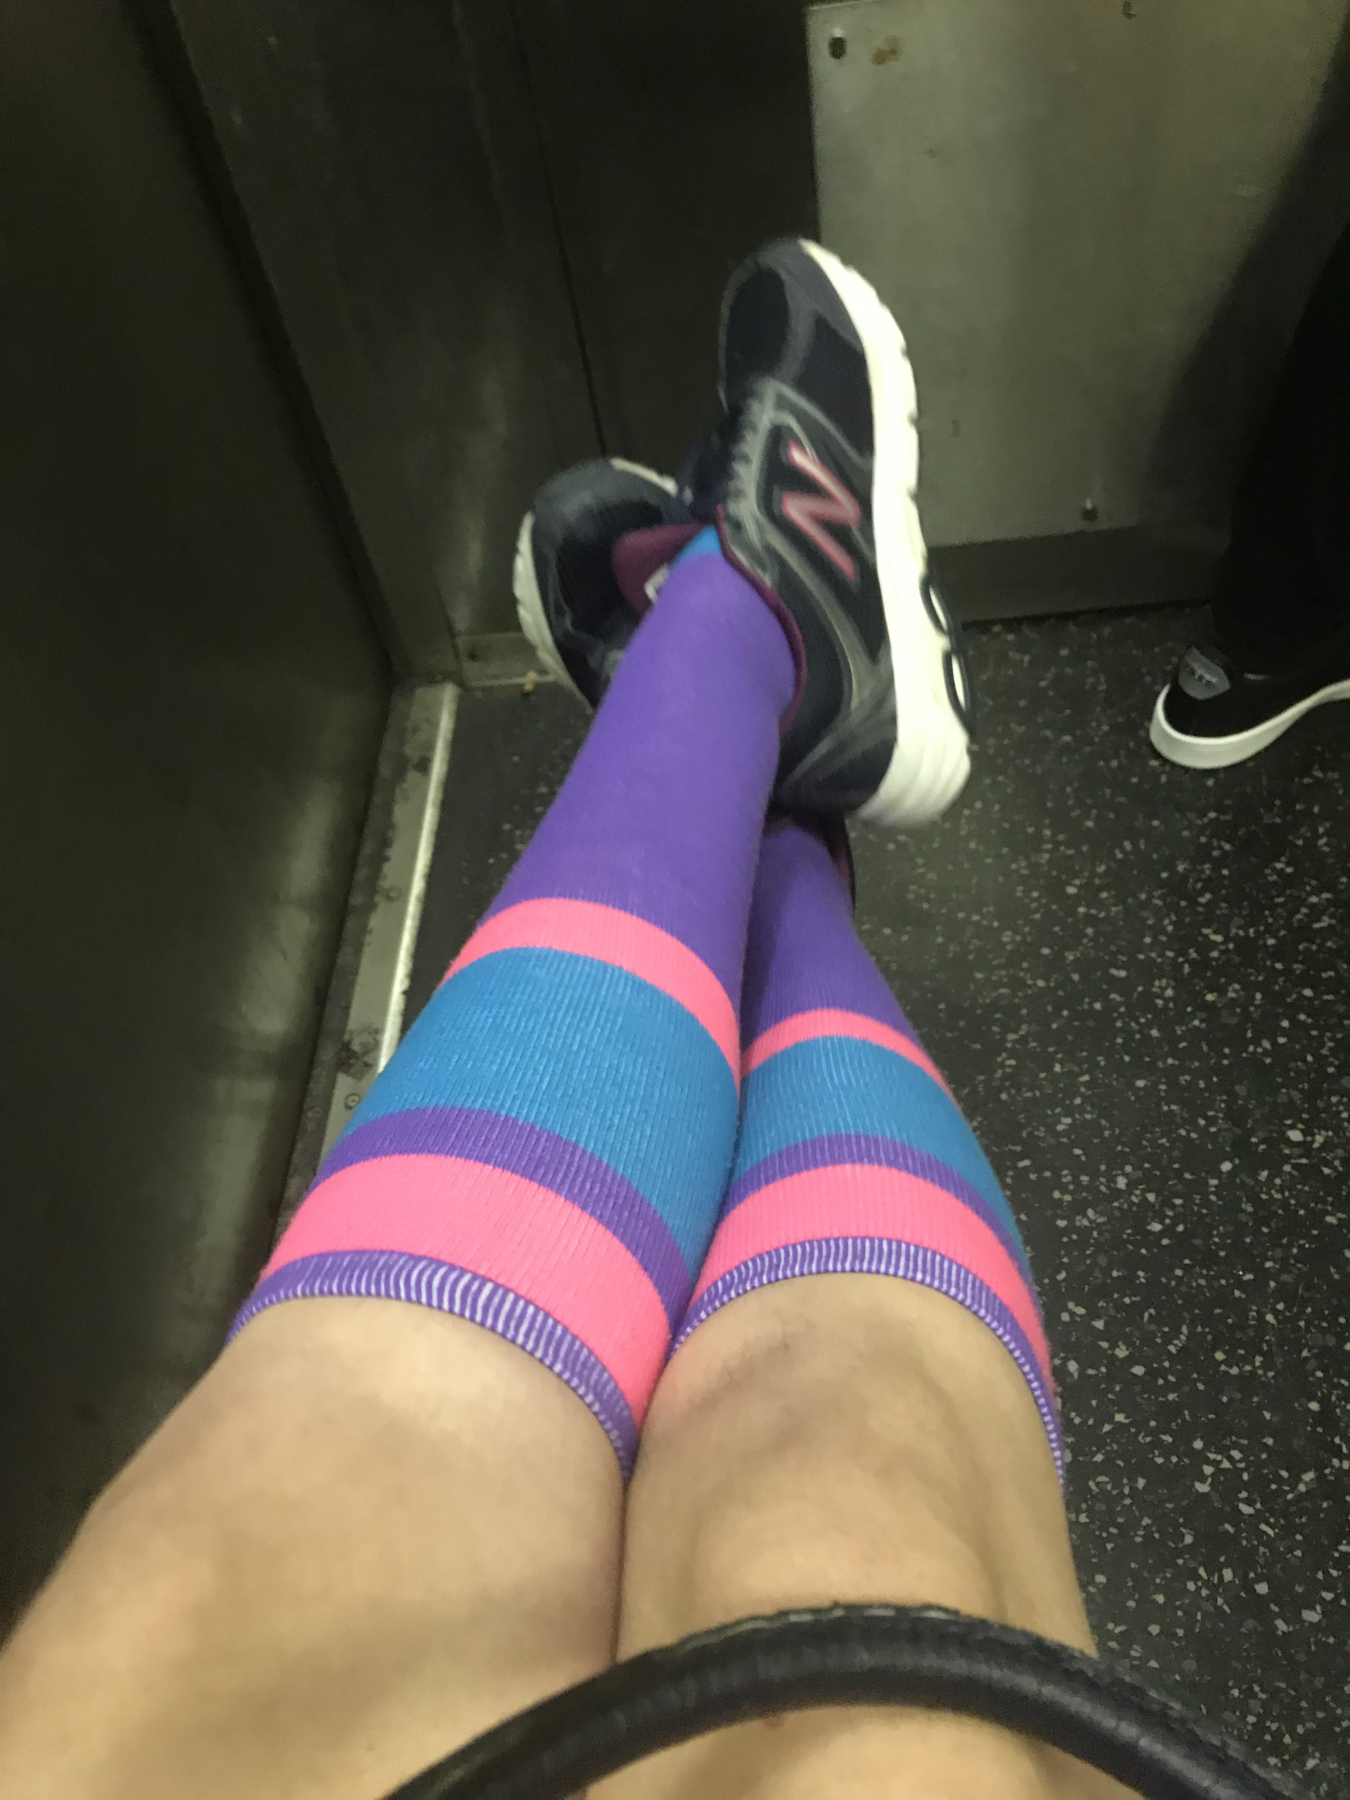
Some examples (Mine)

Slide 6
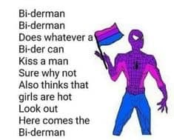
Some more examples (Trends)
Fanfiction, headcanons
Memes
#StillBisexual (and other #s)
Gender-ambiguous language

Slide 7
Some more examples (others)
One person alternates which side of the table he sits on during a weekly seminar so people don’t “pin him down to one side”
“[I want people to know I’m bi, but more importantly] I never want people to assume I’m straight”

Slide 8
Areas I would like feedback ON
What seems like a scope that is both interesting and manageable?
Methods?
  Ethnography of a particular group?
  Digital focus? (maybe a particular hashtag?)
  Online survey with followup?
  If a mix, a different method per chapter?

